Slide 1
Employee Attrition and Salary Prediction
Doing Data Science – Final Project by Branum Stephan

Slide 2
Analysis Goals
The goal of this analysis is to create a prediction model for employee attrition.
Because income is one of the major factors, I will additionally create a model to predict employee salary.

Slide 3
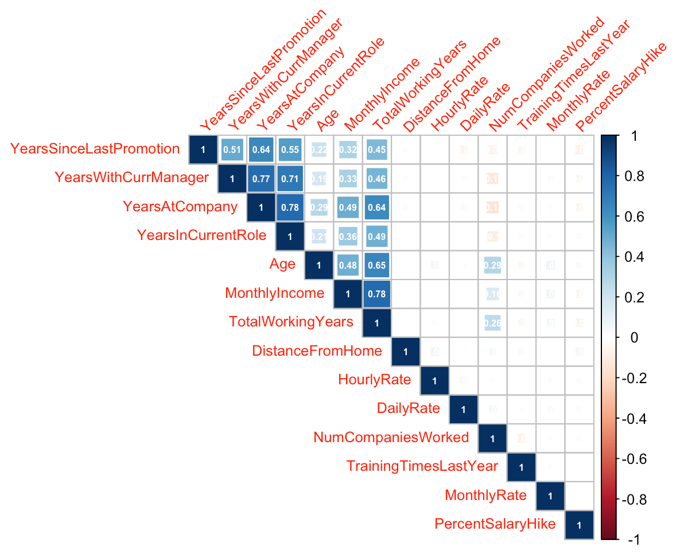
EDA: Numeric Correlation
In order to understand relationships between numerical values, I first created a heatmap, colored by correlation among only the numeric features in the data. Some key points are:
High correlations here:
Monthly Income vs. Total Working Years
Age, Years Since Last Promotion, Years at Company
Importance of minimizing collinearity

Slide 4
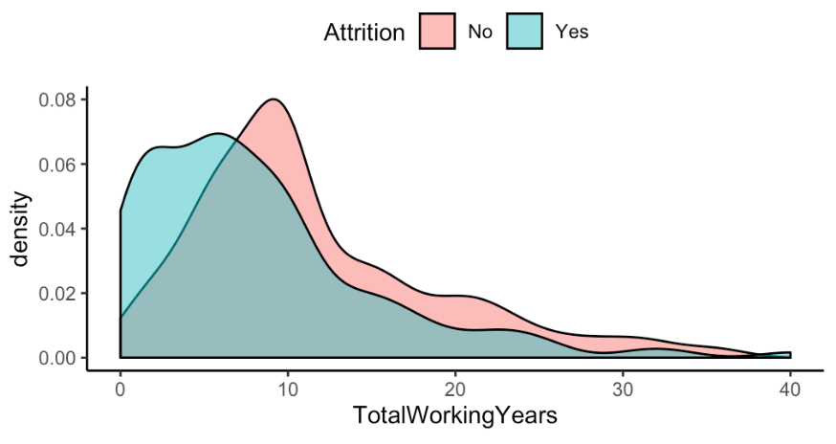
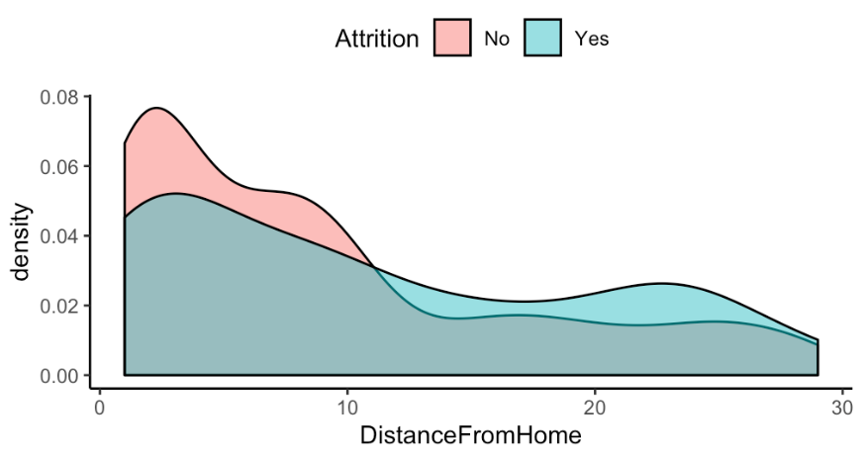
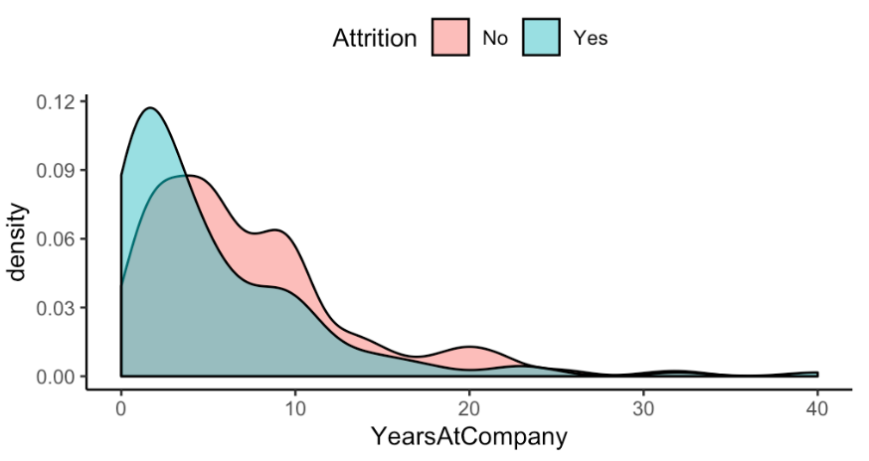
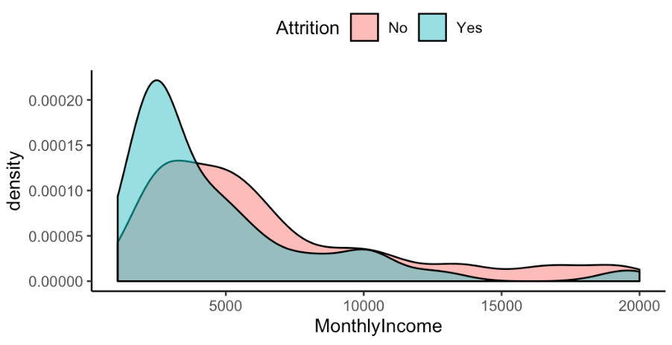
EDA: Numeric Density with Attrition
Noticeable differences between the two groups are evident in Total Working Years, Distance From Home, Years at Company, Monthly Income.
All are correlated besides Distance From Home.

Slide 5
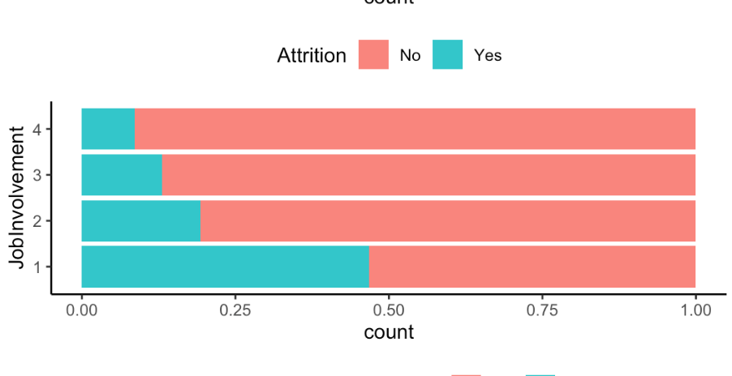
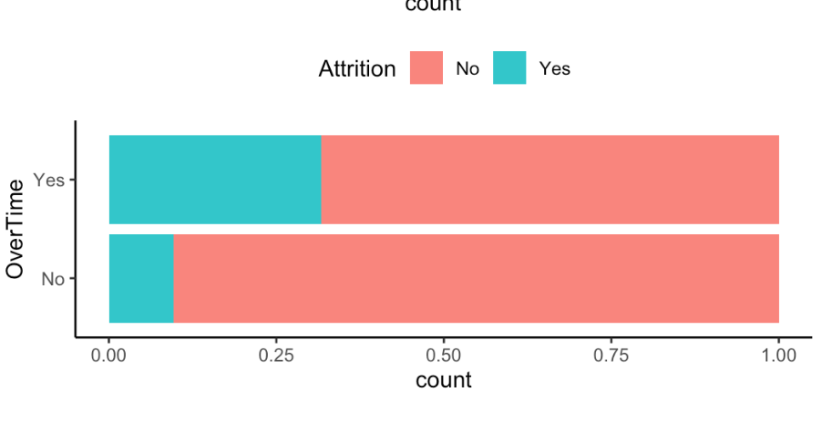
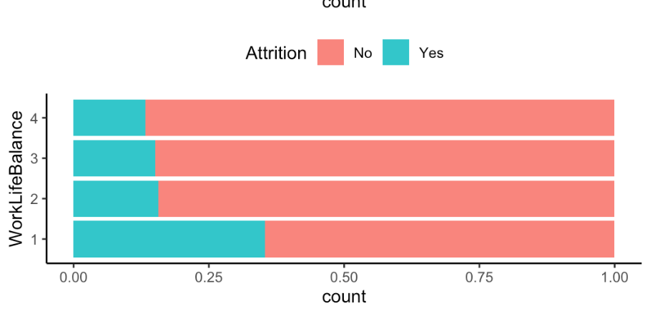
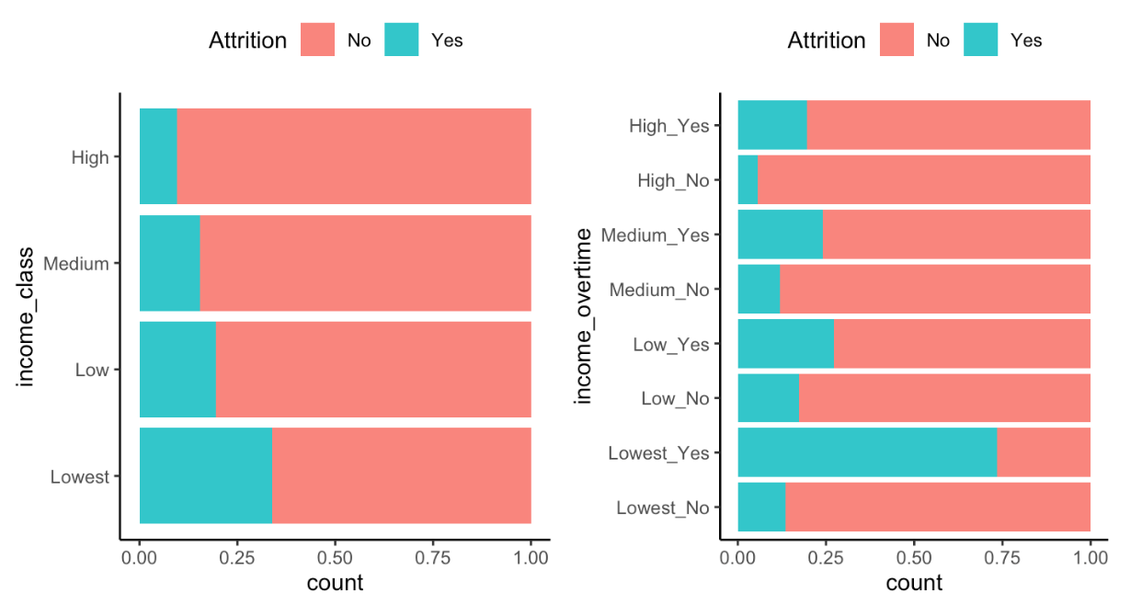
EDA: Categoric Correlation with Attrition
Among the factors that contributed were different between the groups were Job Involvement, Work Life Balance, and Overtime status.
Because overtime status is related with income, I created bins based on the quartiles and combined with overtime status. Notice the large uptick in attrition among those working overtime in the lowest income class.

Slide 6
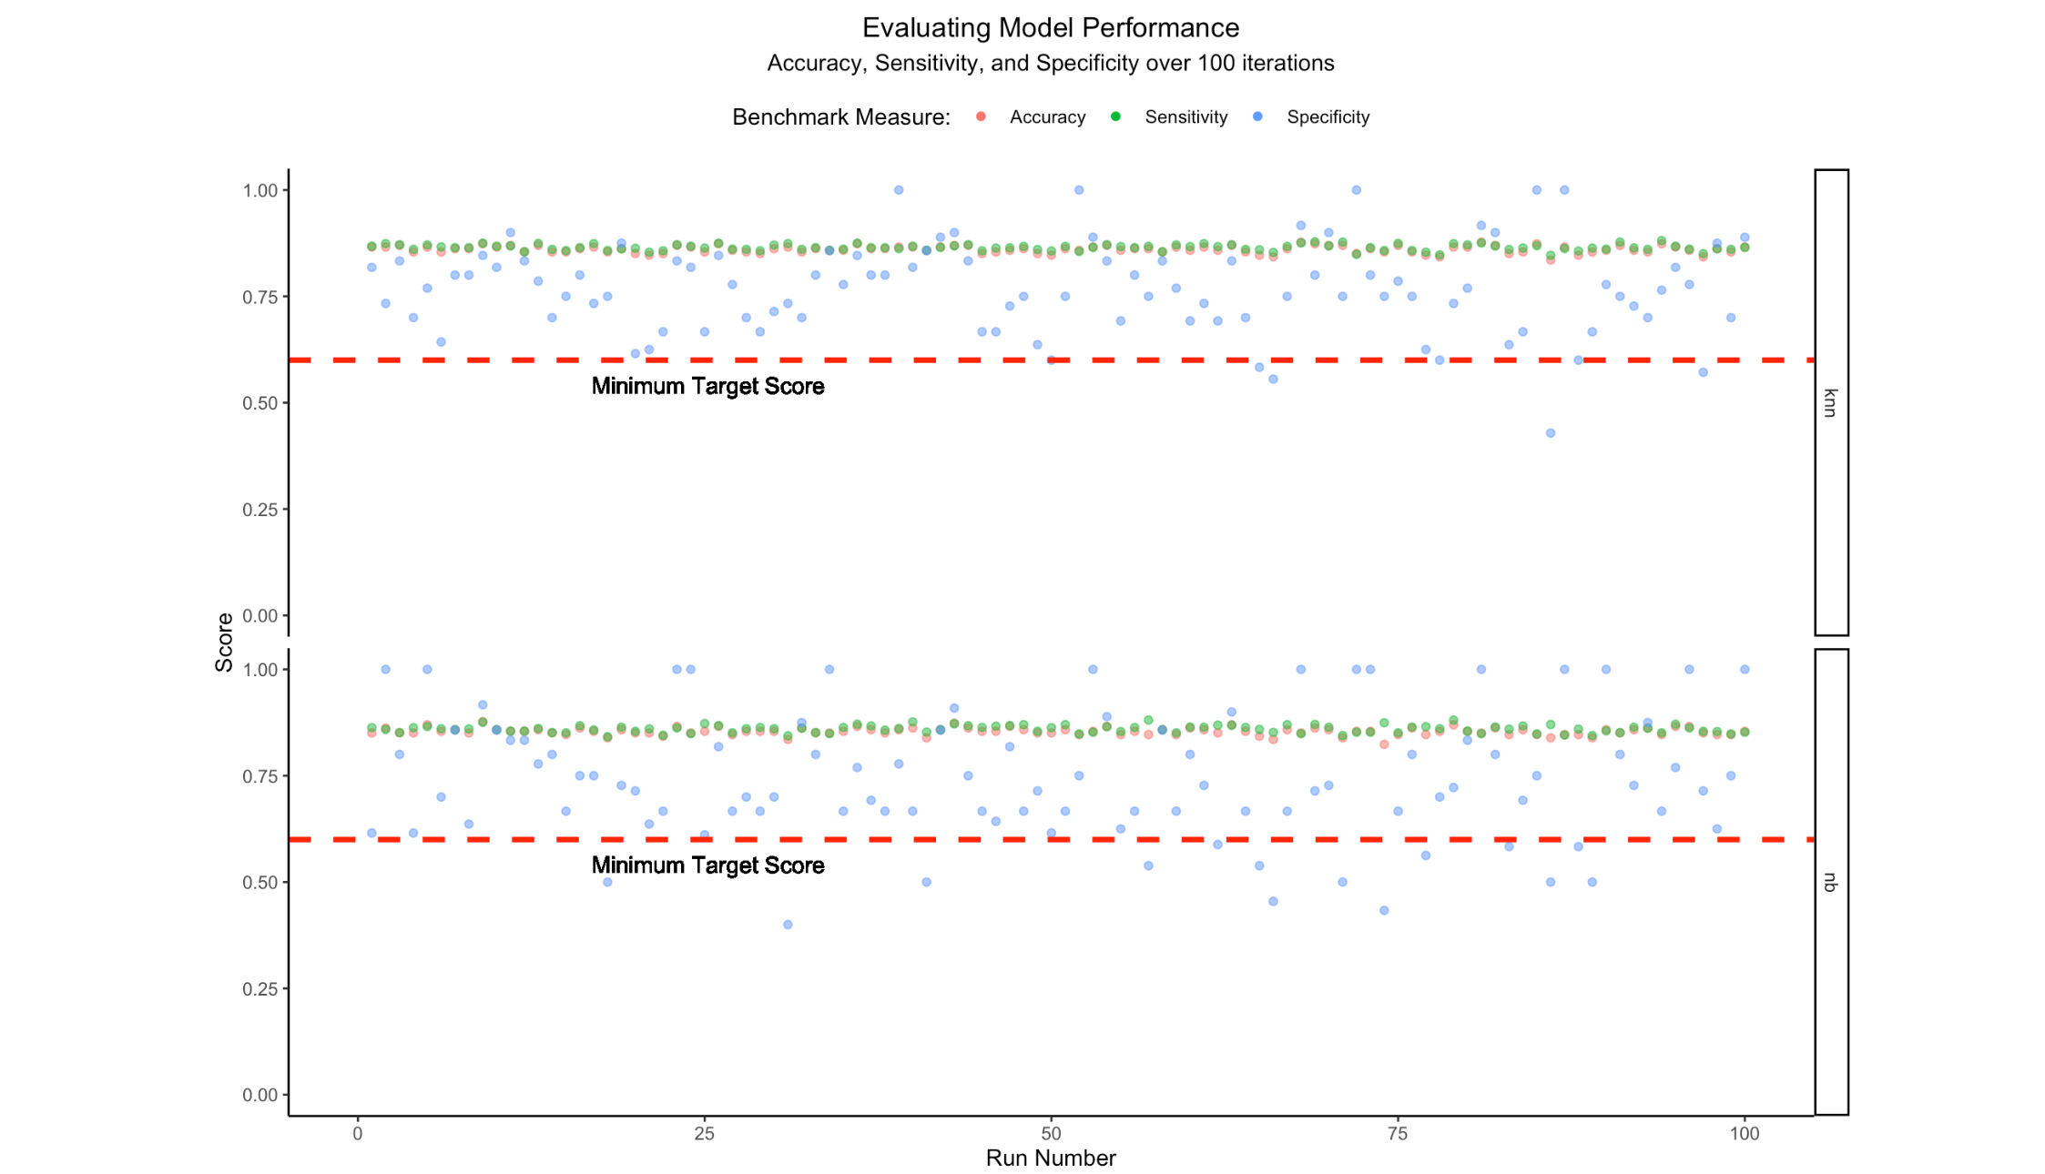
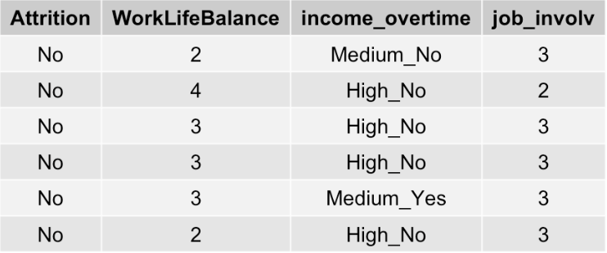
Attrition Prediction Model
Based on 100 random permutations using Naïve Bayes and KNN classification methods with the features above, KNN has appeared to have the upper hand.

Slide 7
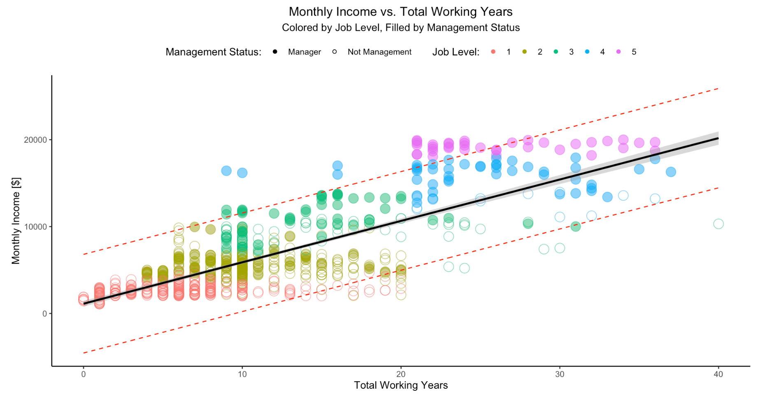
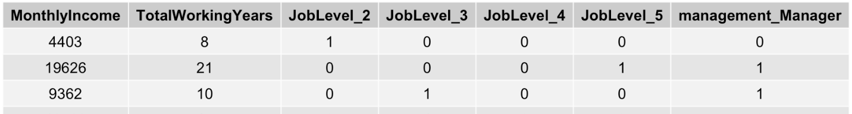
Salary Prediction Model
Linear Equation
Salary = 2522.87 + 37.15(Total Working Years) + 2415.69(Job Level 2 [Y/N]) + 6287.51(Job Level 3 [Y/N]) + 10811.09(Job Level 4 [Y/N]) + 14453.59(Job Level 5 [Y/N]) + 1271.69 (Management Status)
Model Performance
Residual standard error: 1189.94
Multiple R-squared: 0.933478
Adjusted R-squared: 0.933016
Not including the “dummy coding”, I was able to explain 93.3% of the variation in Monthly Income with the use of three variables!

Slide 8
Role Specific Findings
Something interesting that I noticed was that the relative frequency of attrition within the Sales Representative sample. In diving deeper, you can see that sales representatives make have the least median monthly income in the data set, and poor income progression within the company.

Slide 9
Conclusion
Three most important factors for attrition:
Income level with overtime
Work Life Balance
Job Involvement
Three most important factors for salary:
Total Working Years
Job Level
Management Status
Attrition Model Choice is KNN due to less benchmark violations
Attrition Model estimated accuracy is ~86%
Salary Model r-squared of 0.933478
RMSE of 1189.94

